Slide 1
Name: Swapnil Ghosh
Group: A2
Roll: 001911001067
TASK 10

Slide 2
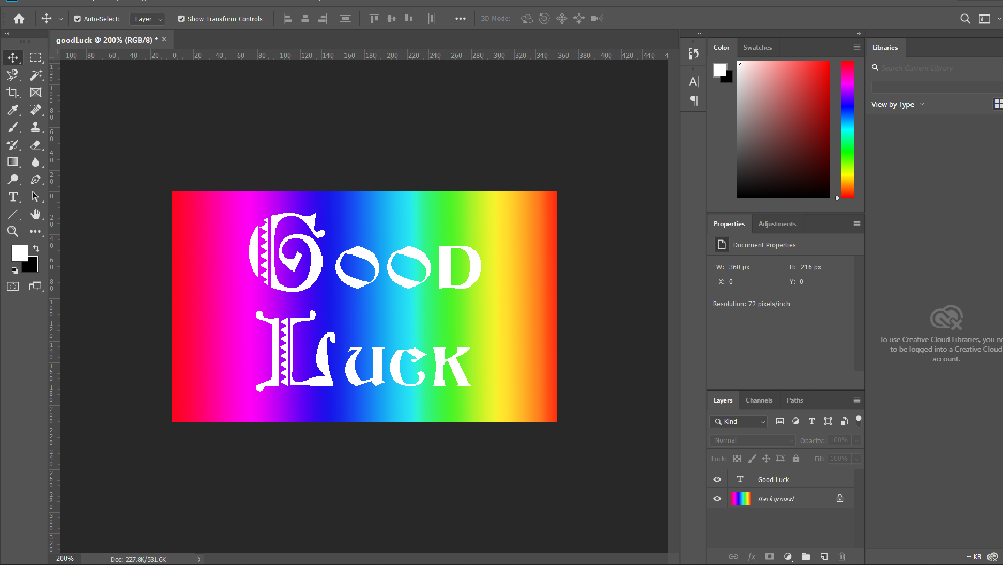
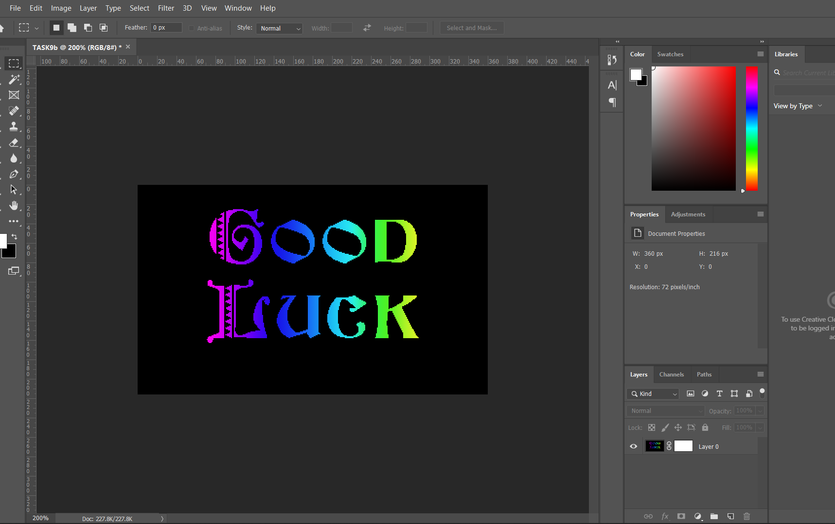
Step-1) Created a new file with 5 inches wide and 3 inches high and background with white color.
Step-2) Applied SPECTRUM gradient horizontally.
Step-3) Used the font FOLKS, size 75, color white, Tracking 100. ype GOOD, press ENTER and then type LUCK
Step-4) Changed the OOD and UCK portions to font BEACON, size 65.
Reposition with Move tool if necessary
Step-6) Repeated the previous steps (1,2) but with black background.
Step-7) Used the Type Mask tool to write the text as before.

